Slide 1



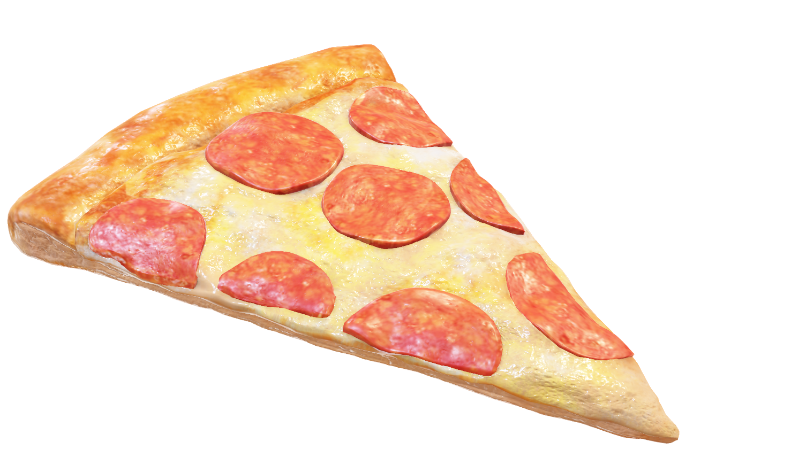
THE GREAT PIZZA ANALYTICS CHALLENGE
IDC PIZZA
TRANSFORMING RAW PIZZA SALES DATA
INTO ACTIONABLE INSIGHTS USING SQL
Organized by: Indian Data Club
Sponsored by: DPDZero

Slide 2


ABOUT THE
ANALYST
MoHd rahil
Skills: SQL • Python • Data Analytics • Data Visualization • Power BI • Advanced Excel • MySQL • ETL • Time Series Analysis • LSTM Models • Machine Learning (Basics) • Data Cleaning • Reporting & Dashboards
Passionate about turning messy datasets into meaningful business insights.

Slide 3

PROJECT OVERVIEW
A HANDS-ON SQL ANALYTICS MINI-PROJECT WHERE, AS THE DATA ANALYST FORIDC PIZZA, MY MISSION IS TO DIVE INTO THE COMPANY'S SALES DATA AND UNCOVER MEANINGFUL TRENDS, PATTERNS, AND BUSINESS INSIGHTS.
GOALS:
Database creation & table design
Filtering, pattern matching & operators
Joins (inner, left, right, full, self)
Aggregations & data summaries
Data cleaning & NULL handling

Slide 4

ABOUT THE IDC
PIZZA DATASET
THE PROJECT USES 4 RELATIONALTABLES STRUCTURED AS:
• pizza _ types — pizza names, categories, ingredients
• pizzas — size, type, and price
• orders — order timestamps
• order details — quantities per order item
Together, these tables build a complete picture of IDC Pizza's operations.

Slide 5

QUESTIONS COVERED (TOTAL 18)
PHASE l: FOUNDATION
1. INSTALL IDC _ PIZZA.DUMP AS IDC _ PIZZA SERVER
IDC _ Pizza.dump is a PostgreSQL backup file. It cannot be
imported into MySQL;
it must be restored in PostgreSQL/pgAdmin.

Slide 6
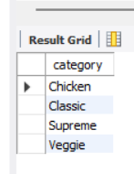
2. List all unique pizza categories (DISTINCT).
QUERY
OUTPUT
select distinct
category
From
pizza_types;

Slide 7
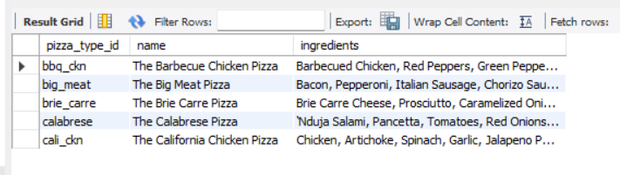
3. Display pizza_type_id, name, and ingredients, replacing NULL ingredients with "Missing Data". Show first 5 rows.
QUERY
OUTPUT
select pizza_type_id,
name,
coalesce(ingredients, 'Missing Data’)
as ingredients
from pizza_types
limit 5;

Slide 8
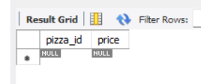
4. Check for pizzas missing a price (IS NULL).
QUERY
OUTPUT
select pizza_id,
price
from pizzas
where price is null;

Slide 9

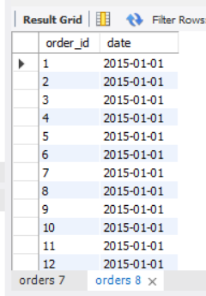
PHASE 2: FILTERING & EXPLORATION
l. ORDERS PLACED ON '2015-01-01' (SELECT + WHERE)
QUERY
OUTPUT
select order_id,
date
from orders
where
date = '2015-01-01';

Slide 10
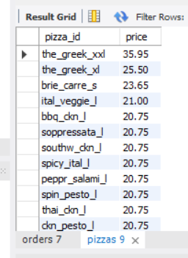
2. List pizzas with `price` descending.
QUERY
OUTPUT
select pizza_id,
price
from pizzas
order by
price desc;

Slide 11
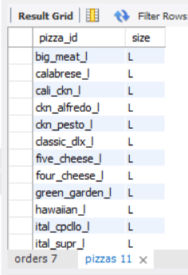
3. Pizzas sold in sizes `'L'` or `'XL'`.
QUERY
OUTPUT
select pizza_id, size
from
pizzas
Where
size = 'L’
or size = 'XL';

Slide 12
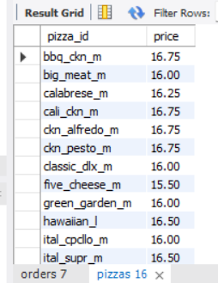
4. Pizzas priced between $15.00 and $17.00.
QUERY
OUTPUT
select pizza_id, price
From
pizzas
Where
Price
between 15.00 and 17.00;

Slide 13
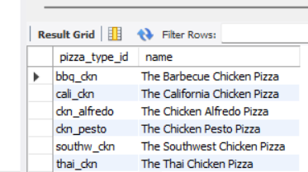
5. Pizzas with `"Chicken"` in the name.
QUERY
OUTPUT
select pizza_type_id, name
From
pizza_types
where
name like '%Chicken%';

Slide 14
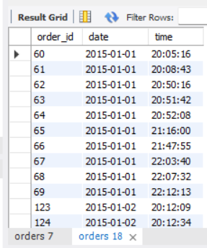
6. Orders on `'2015-02-15'` or placed after 8 PM.
QUERY
OUTPUT
select order_id, date,
time
from orders where date = '2015-02-15’
or time > '20:00:00';

Slide 15

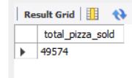
PHASE 3: SALES PERFORMANCE
1. Total quantity of pizzas sold (`SUM`).
QUERY
OUTPUT
select sum(quantity) as total_pizza_sold from order_details;

Slide 16
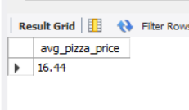
2. Average pizza price (`AVG`).
QUERY
OUTPUT
select round(avg(price),2) as avg_pizza_price from pizzas;

Slide 17
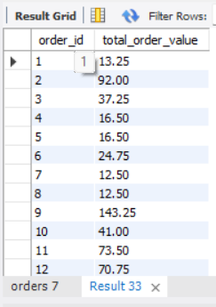
3. Total order value per order (`JOIN`, `SUM`, `GROUP BY`).
QUERY
OUTPUT
select od.order_id, sum(p.price * od.quantity) as total_order_value
from order_details od
join pizzas p on od.pizza_id = p.pizza_id
group by
od.order_id;

Slide 18
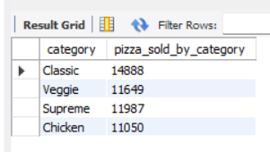
4. Total quantity sold per pizza category (`JOIN`, `GROUP BY`).
QUERY
OUTPUT
select pt.category,
sum(od.quantity) as pizza_sold_by_category
from pizza_types pt
join pizzas p on
pt.pizza_type_id = p.pizza_type_id
join order_details od
on p.pizza_id = od.pizza_id
group by pt.category;

Slide 19
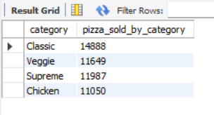
5. Categories with more than 5,000 pizzas sold (`HAVING`).
QUERY
OUTPUT
select pt.category,
sum(od.quantity) as pizza_sold_by_category
from pizza_types pt
join pizzas p
on pt.pizza_type_id = p.pizza_type_id
join order_details od
on p.pizza_id = od.pizza_id
group by pt.category
having
sum(od.quantity) >5000;

Slide 20
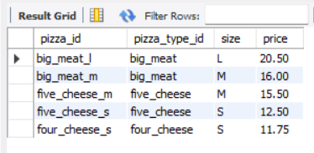
6. Pizzas never ordered (`LEFT/RIGHT JOIN`).
QUERY
OUTPUT
SELECT
p.*
from order_details od
Right join pizzas p
on
p.pizza_id = od.pizza_id
Where
od.pizza_id is null;

Slide 21
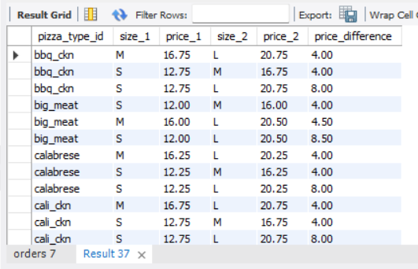
7. Price differences between different sizes
of the same pizza (`SELF JOIN`).
QUERY
OUTPUT
select
p1.pizza_type_id,
p1.size as size_1,
p1.price as price_1,
p2.size as size_2,
p2.price as price_2,
(p2.price - p1.price) as price_difference
from pizzas p1
join pizzas p2
on p1.pizza_type_id = p2.pizza_type_id
and p1.size < p2.
Order by p1.pizza_type_id,
p1.size;

Slide 22

COLLECTIVE INSIGHTS
IDC Pizza sold over 49,000+ pizzas, showing strong demand across categories.
Classic & Chicken categories contribute the highest order volumes and revenue.
Large (L) and Extra Large (XL) sizes are the most frequently ordered across the dataset.
Peak order activity occurs around 6 PM–9 PM, indicating strong dinner-time demand.
Top-selling pizzas belong to the Classic & Supreme categories.
Several pizzas showed NULL or missing data, highlighting the need for data validation.
A few pizzas were never ordered, indicating either low visibility or low customer interest.
Most revenue is generated from mid-priced pizzas ($15–$20 range). Ingredients analysis shows cheese-based and chicken-based pizzas dominate preferences.
Day-wise sales reveal weekends outperform weekdays, especially Saturdays. Monthly trends show January and February as high-performing sales months.
High-value orders often include multiple large pizzas, boosting overall revenue.
Self-join analysis reveals clear price gaps between sizes, aiding pricing strategy.
Filtering & NULL handling cleaned the dataset, improving overall query reliability

Slide 23
Thank you
PREPARED BY: MOHD RAHIL

